Slide 1
Fluid flow
FLUID DYNAMIC

Slide 2
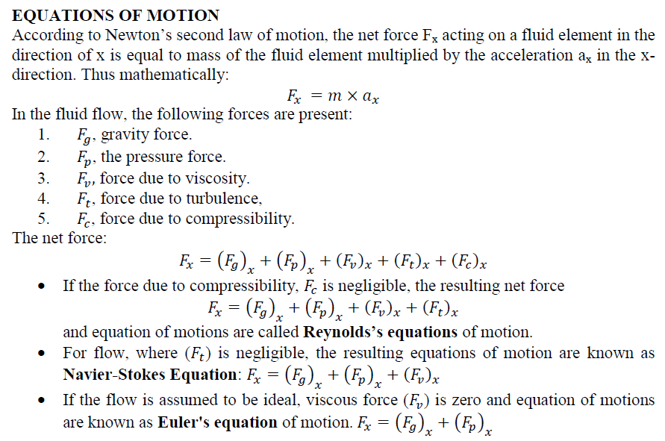

Slide 3
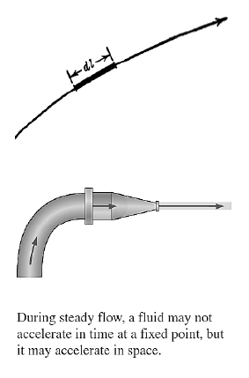
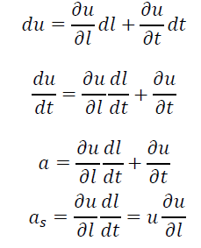
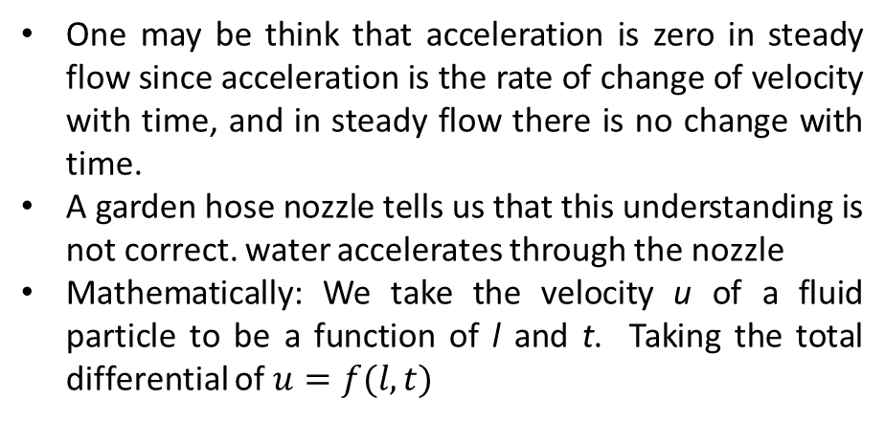

Velocity and acceleration of fluid flow particle
The velocity of a particle moving along a streamline in a fluid flow may be expressed by
$$u=\frac{dl}{dt}$$
One may be think that acceleration is zero in steady flow since acceleration is the rate of change of velocity with time, and in steady flow there is no change with time.
A garden hose nozzle tells us that this understanding is not correct. water accelerates through the nozzle
Mathematically: We take the velocity u of a fluid particle to be a function of l and t. Taking the total differential of $u=f(l, t)$

Slide 4
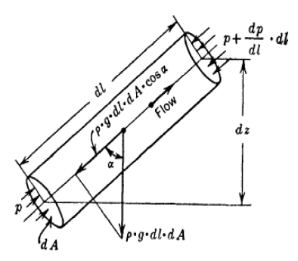
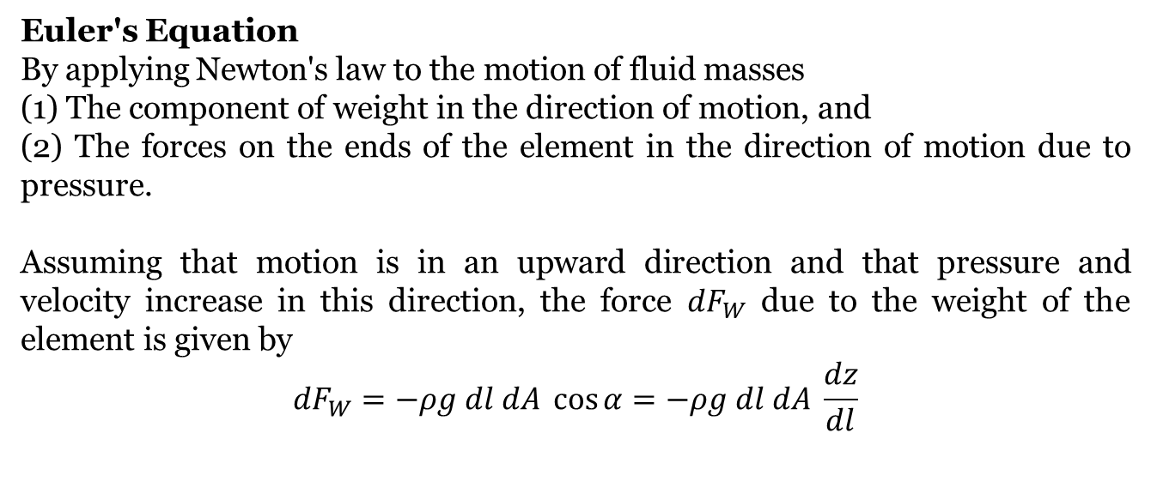
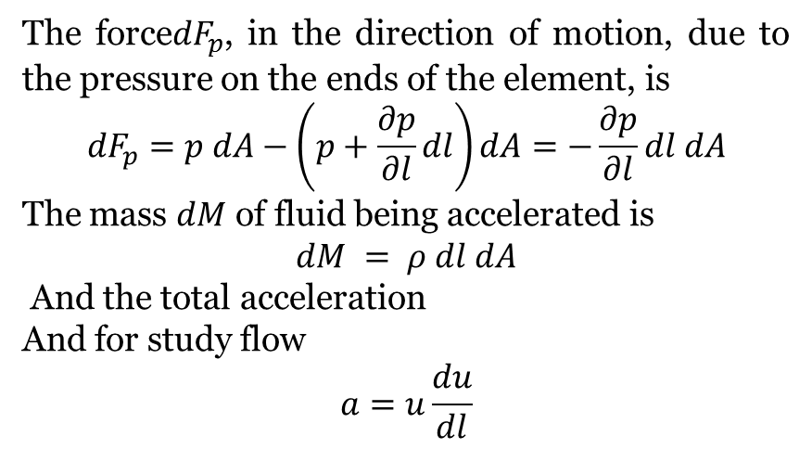
Euler's Equation
By applying Newton's law to the motion of fluid masses
(1) The component of weight in the direction of motion, and
(2) The forces on the ends of the element in the direction of motion due to pressure.
Assuming that motion is in an upward direction and that pressure and velocity increase in this direction, the force ${dF}_{W}$ due to the weight of the element is given by
$${dF}_{W}=−ρg dl dA \cos{α}=−ρg dl dA \frac{dz}{dl}$$
The force${dF}_{p}$, in the direction of motion, due to the pressure on the ends of the element, is
$${dF}_{p}=p dA−\left(p+\frac{∂p}{∂l}dl\right)dA=−\frac{∂p}{∂l}dl dA$$
The mass $dM$ of fluid being accelerated is
$$dM = ρ dl dA$$
And the total acceleration
And for study flow
$$a=u\frac{du}{dl}$$

Slide 5
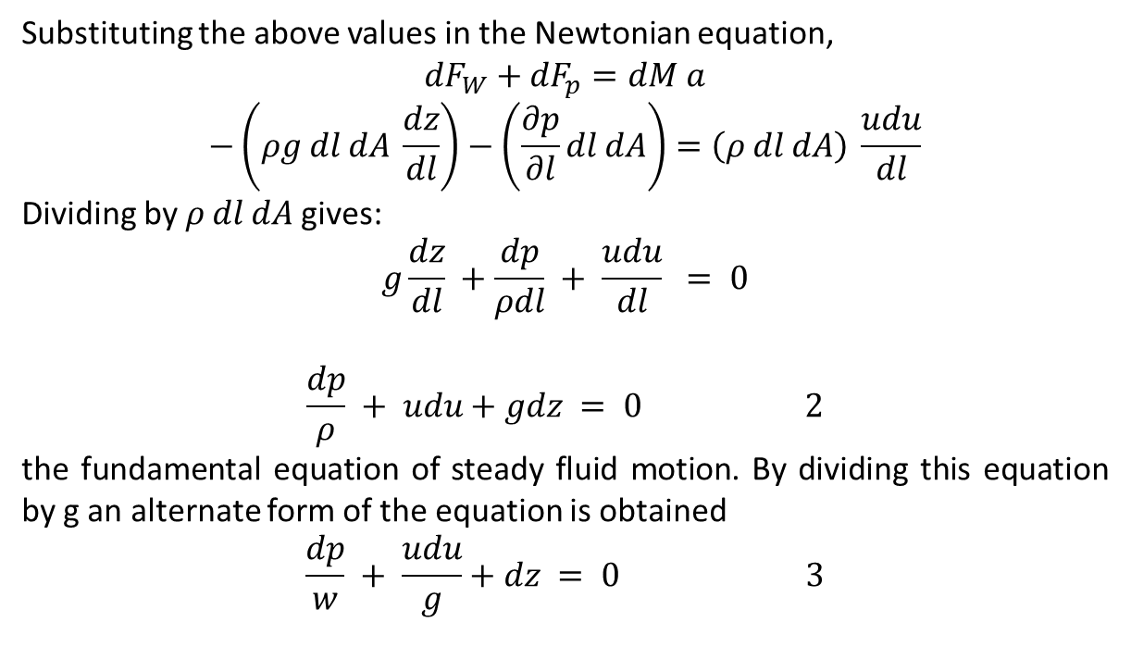
Substituting the above values in the Newtonian equation,
$${dF}_{W}+{dF}_{p}=dM a$$
$$−\left(ρg dl dA \frac{dz}{dl}\right)−\left(\frac{∂p}{∂l}dl dA\right)=\left(ρ dl dA\right) \frac{udu}{dl}$$
Dividing by $ρ dl dA$ gives:
$$g\frac{dz}{dl} +\frac{dp}{ρdl} + \frac{udu}{dl} = 0$$
$$\frac{dp}{ρ} + udu+gdz = 0 2$$
the fundamental equation of steady fluid motion. By dividing this equation by g an alternate form of the equation is obtained
$$\frac{dp}{w} + \frac{udu}{g}+dz = 0 3$$

Slide 6
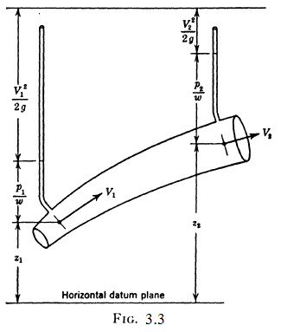
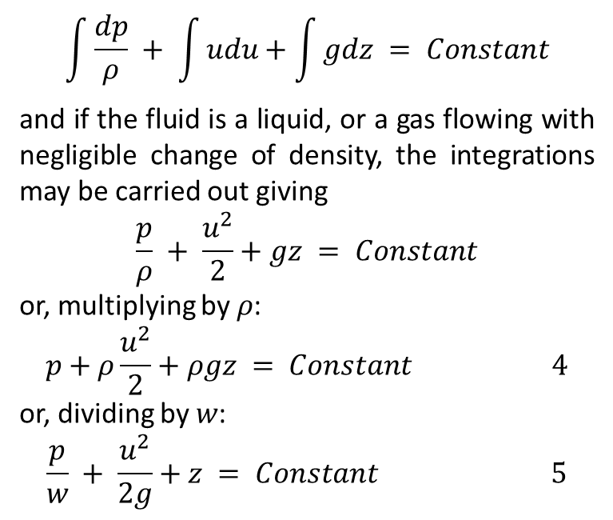
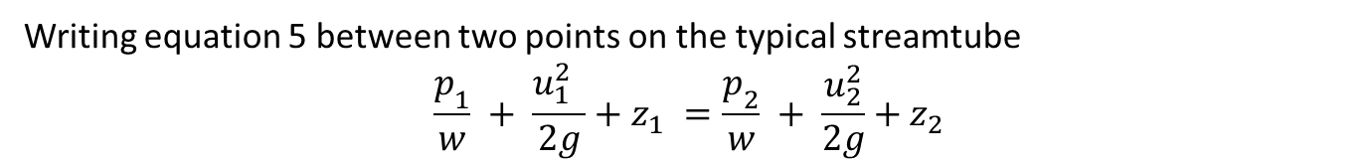
Bernoulli's Equation
Euler's equation may be integrated along the streamtube with the following result
$$\int{\frac{dp}{ρ} }+ \int{udu}+\int{gdz} = Constant$$
and if the fluid is a liquid, or a gas flowing with negligible change of density, the integrations may be carried out giving
$$\frac{p}{ρ} + \frac{u^{2}}{2}+gz = Constant$$
or, multiplying by$ρ$:
$$p+ρ\frac{u^{2}}{2}+ρgz = Constant 4$$
or, dividing by $w$:
$$\frac{p}{w} + \frac{u^{2}}{2g}+z = Constant 5$$
Writing equation 5 between two points on the typical streamtube
$$\frac{p_{1}}{w} + \frac{{{u_{1}^{2}}^{ }}_{ }}{2g}+z_{1} =\frac{p_{2}}{w} + \frac{u_{2}^{2}}{2g}+z_{2}$$

Slide 7
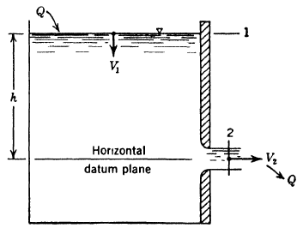
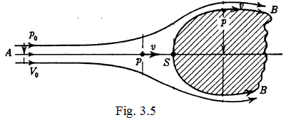
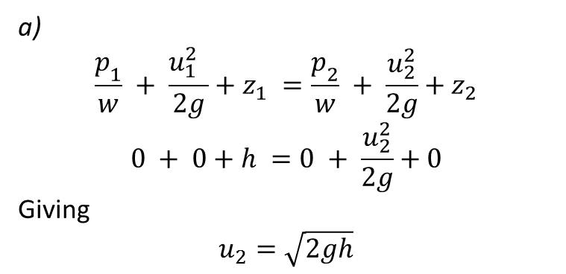
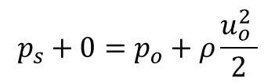
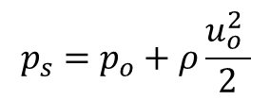
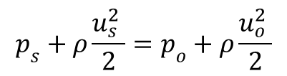
Application of Bernoulli's equation
a)
$$\frac{p_{1}}{w} + \frac{{{u_{1}^{2}}^{ }}_{ }}{2g}+z_{1} =\frac{p_{2}}{w} + \frac{u_{2}^{2}}{2g}+z_{2}$$
$$0 + 0+h =0 + \frac{u_{2}^{2}}{2g}+0$$
Giving
$$u_{2}=\sqrt{2gh}$$
$$p_{s}+ρ\frac{{u_{s}^{2}}^{ }}{2}=p_{o}+ρ\frac{{u_{o}^{2}}^{ }}{2}$$
$$p_{s}+0=p_{o}+ρ\frac{{u_{o}^{2}}^{ }}{2}$$
$$p_{s}=p_{o}+ρ\frac{{u_{o}^{2}}^{ }}{2}$$

Slide 8
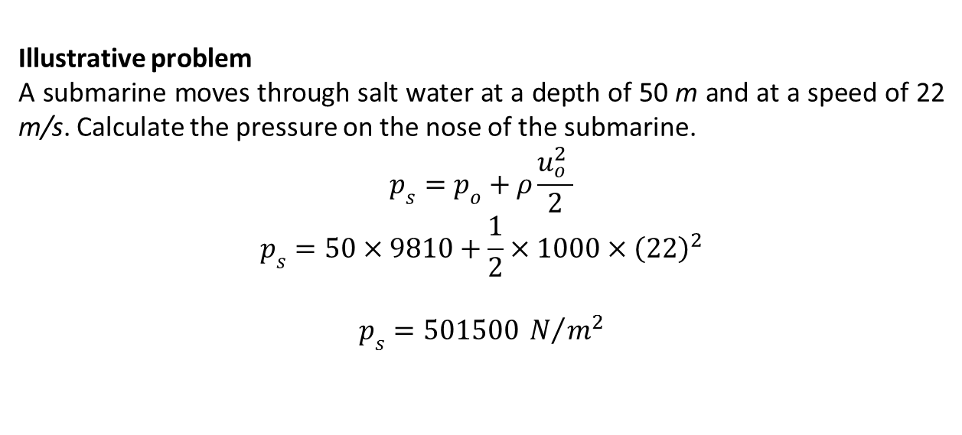
Illustrative problem
A submarine moves through salt water at a depth of 50 m and at a speed of 22 m/s. Calculate the pressure on the nose of the submarine.
$$p_{s}=p_{o}+ρ\frac{{u_{o}^{2}}^{ }}{2}$$
$$p_{s}=50×9810+\frac{1}{2}×1000×{\left(22\right)}^{2}$$
$$p_{s}=501500 N/{m^{2}}$$

Slide 9
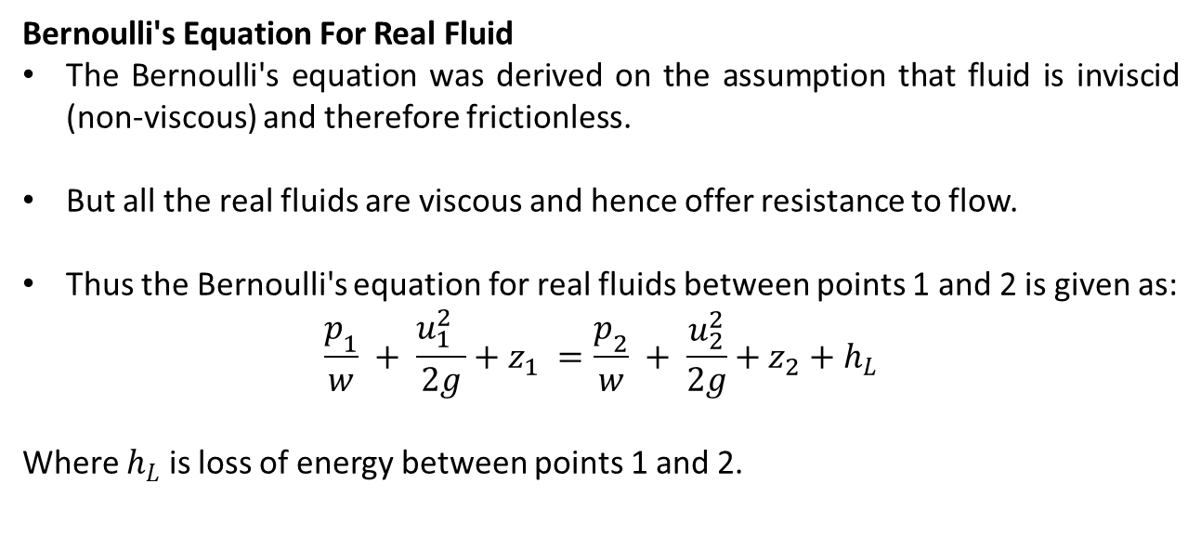
Bernoulli's Equation For Real Fluid
The Bernoulli's equation was derived on the assumption that fluid is inviscid (non-viscous) and therefore frictionless.
But all the real fluids are viscous and hence offer resistance to flow.
Thus the Bernoulli's equation for real fluids between points 1 and 2 is given as:
$$\frac{p_{1}}{w} + \frac{{{u_{1}^{2}}^{ }}_{ }}{2g}+z_{1} =\frac{p_{2}}{w} + \frac{u_{2}^{2}}{2g}+z_{2}+h_{L}$$
Where $h_{L}$ is loss of energy between points 1 and 2.

Slide 10
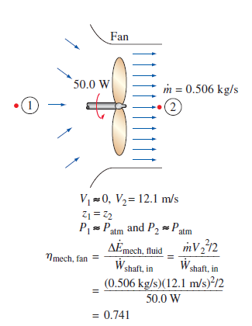
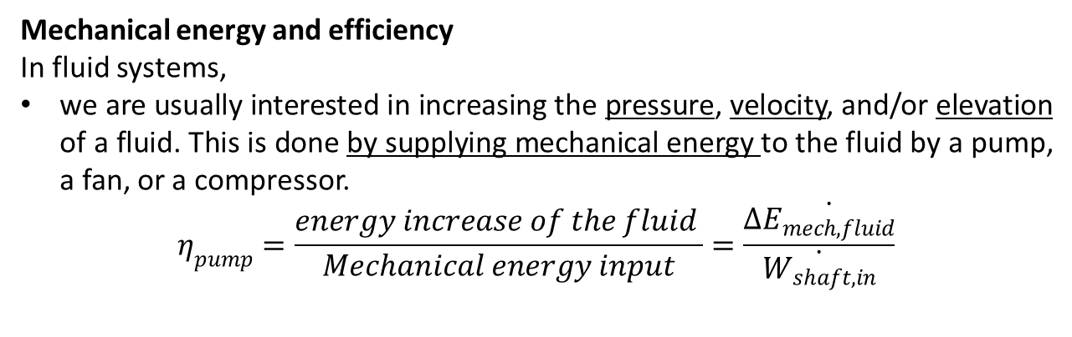
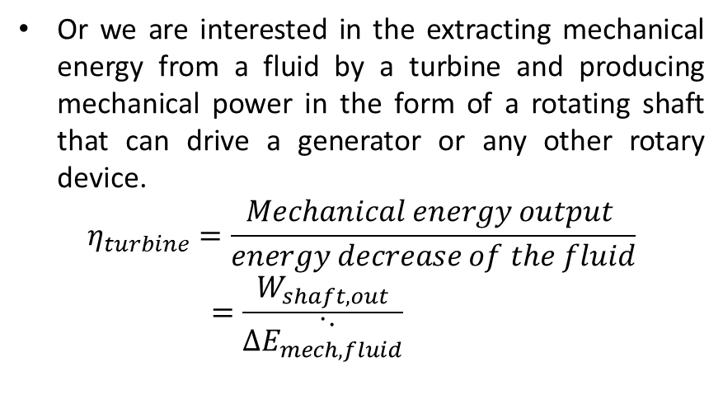
Mechanical energy and efficiency
In fluid systems,
we are usually interested in increasing the pressure, velocity, and/or elevation of a fluid. This is done by supplying mechanical energy to the fluid by a pump, a fan, or a compressor.
$$η_{pump}=\frac{energy increase of the fluid }{Mechanical energy input}=\frac{∆\dot{E_{mech, fluid}}}{\dot{W_{shaft, in}}}$$
Or we are interested in the extracting mechanical energy from a fluid by a turbine and producing mechanical power in the form of a rotating shaft that can drive a generator or any other rotary device.
$$η_{turbine}=\frac{Mechanical energy output }{energy decrease of the fluid}=\frac{W_{shaft, out}}{\dot{∆\dot{E_{mech, fluid}}}}$$

Slide 11
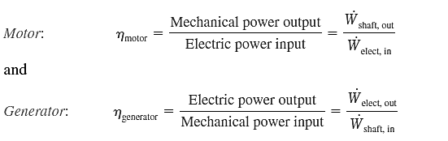
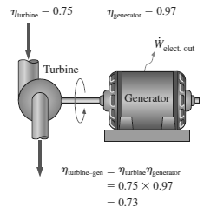
The mechanical efficiency should not be confused with the motor efficiency and the generator efficiency, which are defined as:
A pump is usually packaged together with its motor
and a turbine with its generator.
See the fig for overall efficiency of pump–motor and turbine–generator combinations

Slide 12
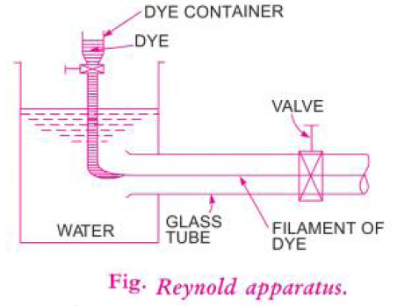
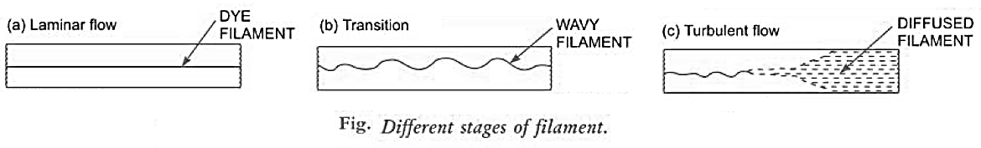
INTERNAL FLOW
Fluid flow is classified as external or internal, depending on whether the fluid is forced to flow over a surface or in a conduit.
Laminar and Turbulent Flows
Reynolds experiment

Slide 13
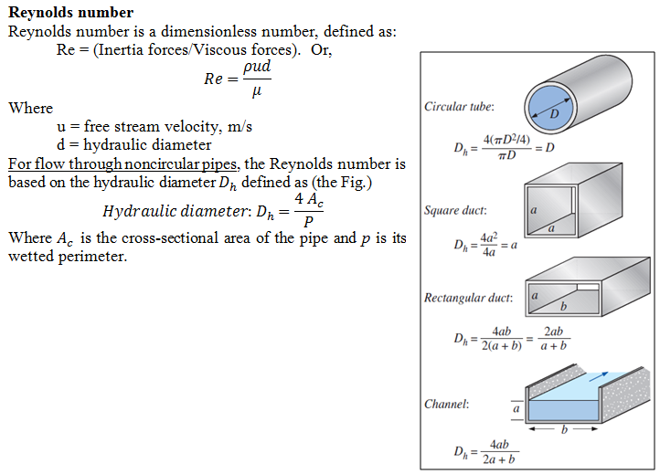

Slide 14
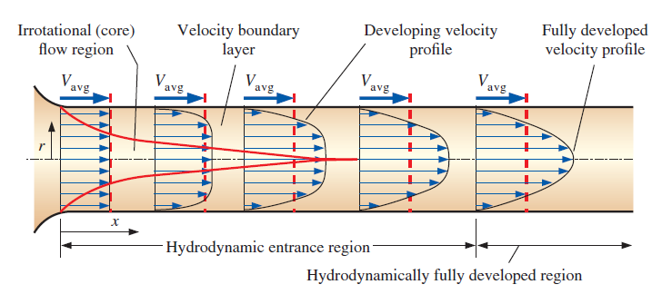
The entrance region
Because of the no-slip condition, the fluid particles in the layer in contact with the wall of the pipe come to a complete stop.
This layer also causes the fluid particles in the adjacent layers to slow down gradually as a result of friction.
To make up for this velocity reduction, the velocity of the fluid at the midsection of the pipe has to increase to keep the mass flow rate through the pipe constant. As a result, a velocity gradient develops along the pipe.
The hypothetical boundary surface divides the flow in a pipe into two regions:
the boundary layer region, in which the viscous effects and the velocity changes are significant, and
the irrotational (core) flow region
the hydrodynamic entry length.

Slide 15
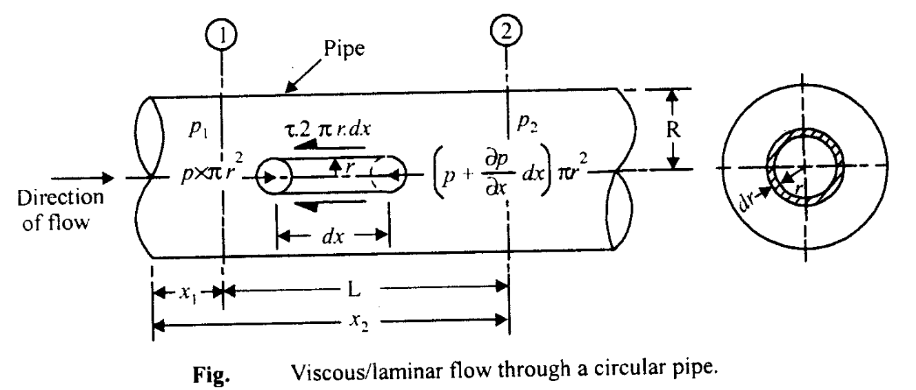
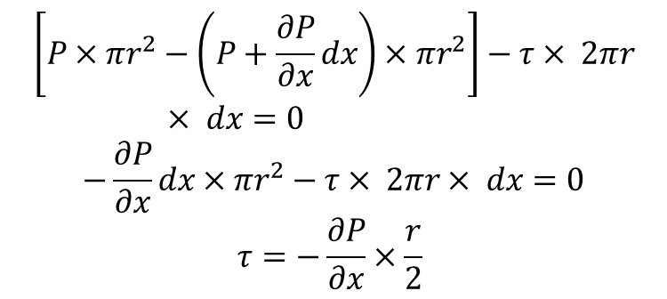
Laminar Flow
Flow of Viscous Fluid in Circular Pipes-Hagen Poiseuille Law
$$\left[P×πr^{2}−\left(P+\frac{∂P}{∂x}dx\right)×πr^{2}\right]−τ× 2πr× dx=0$$
$$−\frac{∂P}{∂x}dx×πr^{2}−τ× 2πr× dx=0$$
$$τ=−\frac{∂P}{∂x}×\frac{r}{2}$$

Slide 16
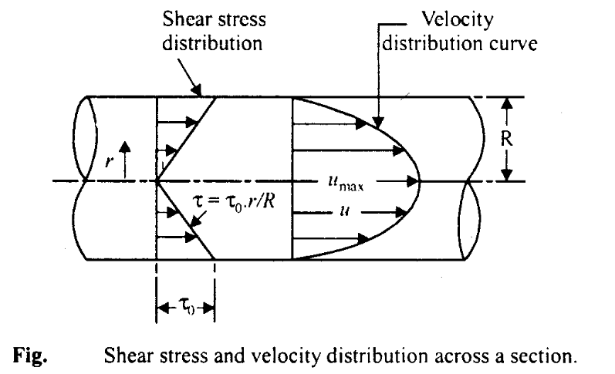
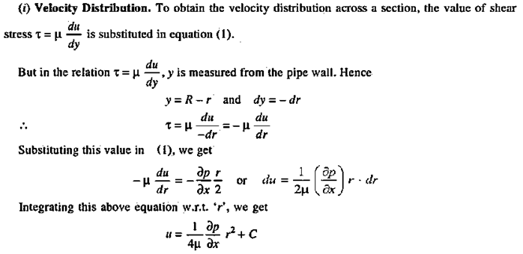
Eqn. (1) indicates that the shear stress varies linearly across the section (see the next Fig.). Its value is zero at the centre of pipe (r = 0) and maximum at the pipe wall

Slide 17
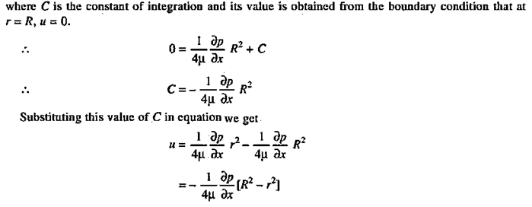
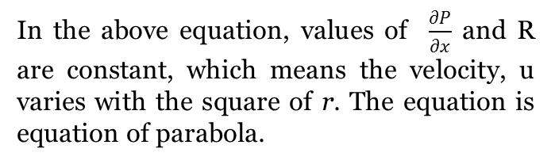
In the above equation, values of $\frac{∂P}{∂x}$ and R are constant, which means the velocity, u varies with the square of r. The equation is equation of parabola.

Slide 18
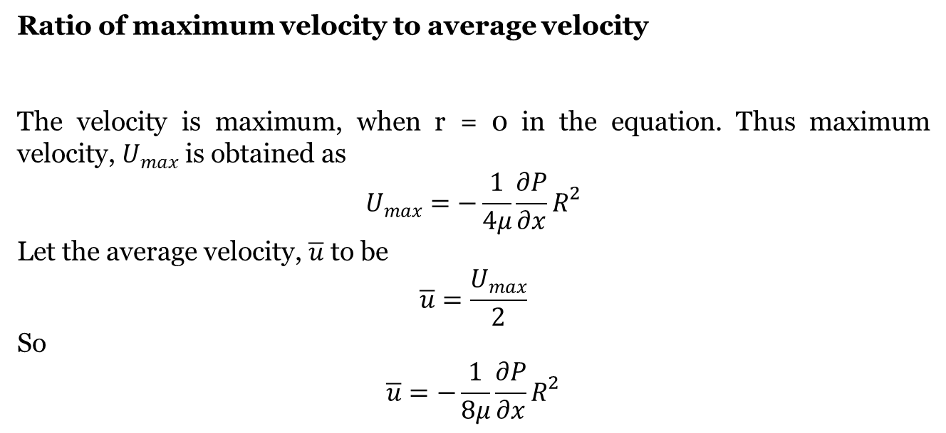
Ratio of maximum velocity to average velocity
The velocity is maximum, when r = 0 in the equation. Thus maximum velocity, $U_{max}$ is obtained as
$$U_{max}=−\frac{1}{4μ}\frac{∂P}{∂x}R^{2}$$
Let the average velocity, $\overline{u}$ to be
$$\overline{u}=\frac{U_{max}}{2}$$
So
$$\overline{u}=−\frac{1}{8μ}\frac{∂P}{∂x}R^{2}$$

Slide 19
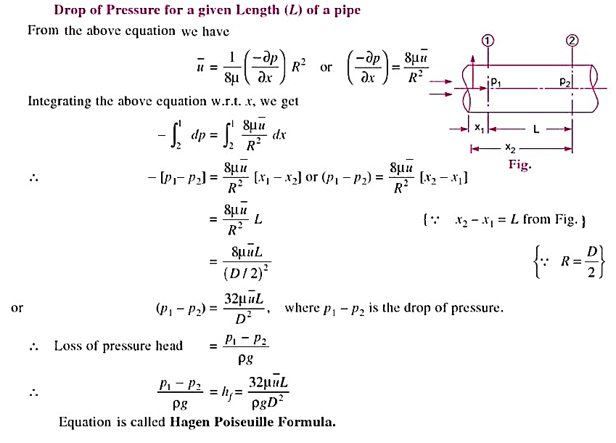

Slide 20
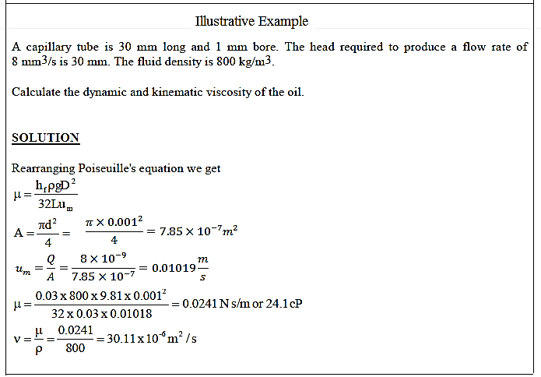

Slide 21
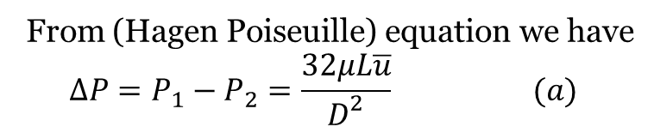
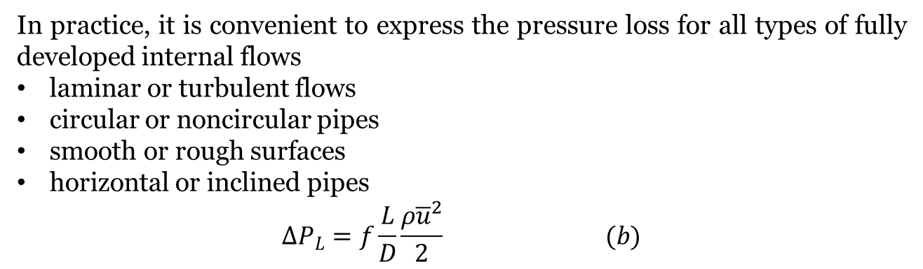
Pressure Drop and Head Loss
From (Hagen Poiseuille) equation we have
$$∆P=P_{1}−P_{2}=\frac{32μL\overline{u}}{D^{2}} (a)$$
Note from Eq. (a) that the pressure drop is proportional to the viscosity $μ$ of the fluid, and $∆P$ would be zero if there were no friction.
In practice, it is convenient to express the pressure loss for all types of fully developed internal flows
laminar or turbulent flows
circular or noncircular pipes
smooth or rough surfaces
horizontal or inclined pipes
$$∆P_{L}=f\frac{L}{D}\frac{ρ{\overline{u}}^{2}}{2} (b)$$
Setting Eqs. (a) and (b) equal to each other and solving for$f$
$$f=\frac{64μ}{ρD\overline{u}}=\frac{64}{Re} \left(c\right) for more information see the appendex of ch. 4$$

Slide 22
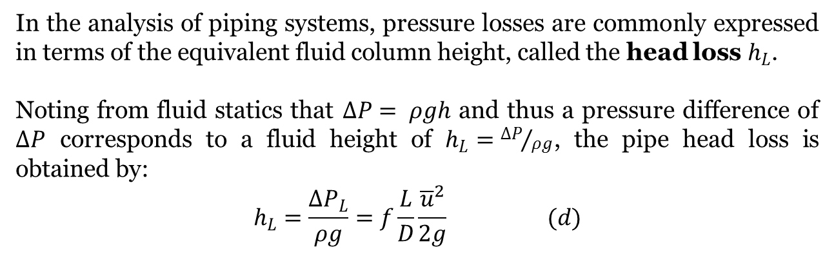
The equation shows that in laminar flow, the friction factor is a function of the Reynolds number only and is independent of the roughness of the pipe surface
In the analysis of piping systems, pressure losses are commonly expressed in terms of the equivalent fluid column height, called the head loss $h_{L}$.
Noting from fluid statics that $∆P= ρgh$ and thus a pressure difference of $∆P$ corresponds to a fluid height of $h_{L}={∆P}/{ρg}$, the pipe head loss is obtained by:
$$h_{L}=\frac{∆P_{L}}{ρg}=f\frac{L}{D}\frac{{\overline{u}}^{2}}{2g} (d)$$

Slide 23
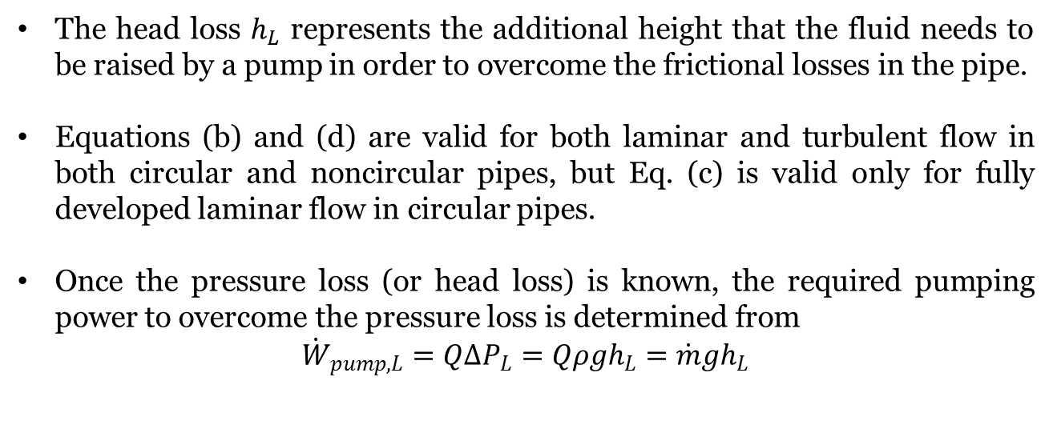
The head loss $h_{L}$ represents the additional height that the fluid needs to be raised by a pump in order to overcome the frictional losses in the pipe.
Equations (b) and (d) are valid for both laminar and turbulent flow in both circular and noncircular pipes, but Eq. (c) is valid only for fully developed laminar flow in circular pipes.
Once the pressure loss (or head loss) is known, the required pumping power to overcome the pressure loss is determined from
$${\dot{W}}_{pump,L}=Q∆P_{L}=Qρgh_{L}=\dot{m}gh_{L}$$

Slide 24
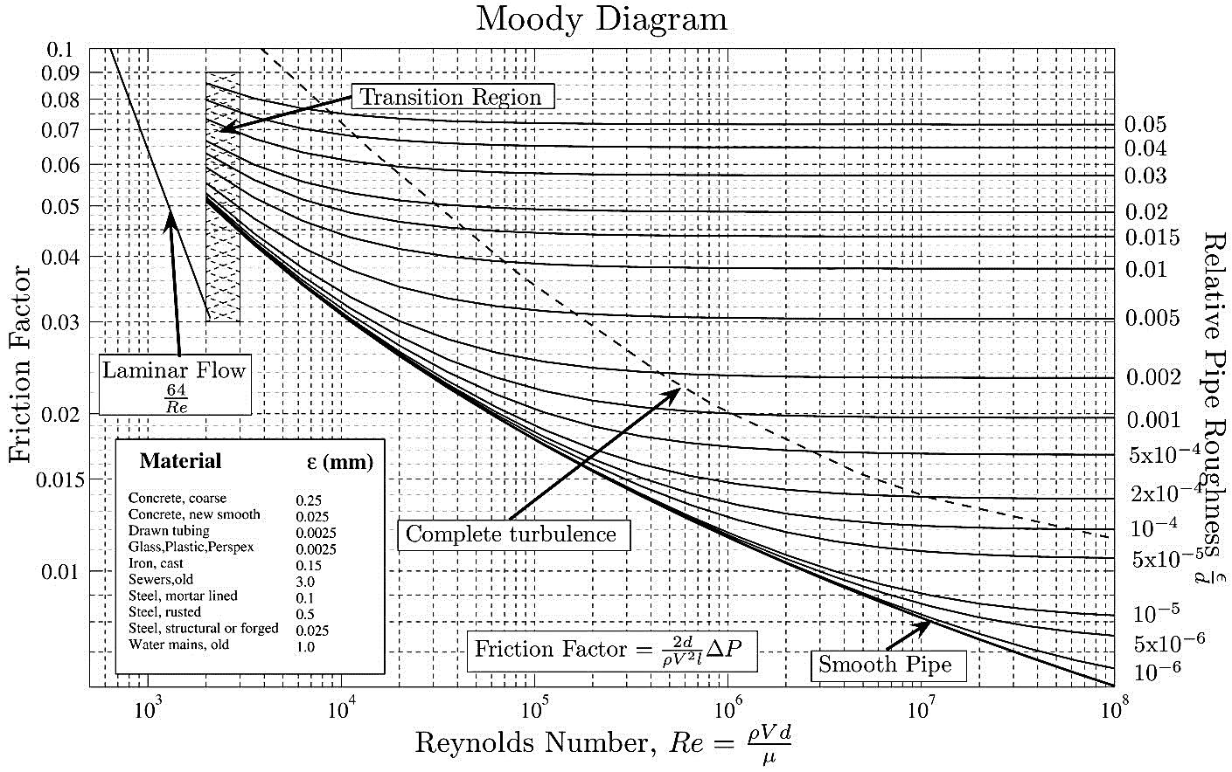
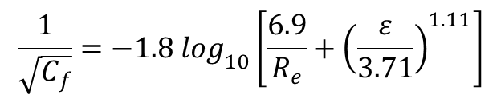
$$\frac{1}{\sqrt{C_{f}}}=−1.8 \log_{10}\left[\frac{6.9}{R_{e}}+{\left(\frac{ε}{3.71}\right)}^{1.11}\right]$$

Slide 25
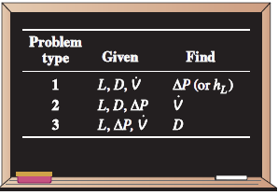
Types of fluid flow problems
In the design and analysis of piping systems that involve the use of the
Moody chart, we usually encounter three types of problems (the fluid and the roughness of the pipe are assumed to be specified in all cases)
1. Determining the pressure drop (or head loss) when the pipe length and diameter are given for a specified flow rate (or velocity)
2. Determining the flow rate when the pipe length and diameter are given for a specified pressure drop (or head loss)
3. Determining the pipe diameter when the pipe length and flow rate are given for a specified pressure drop (or head loss)

Slide 26
Minor Losses
The fluid in a typical piping system passes through various fittings, valves, bends, elbows, tees, inlets, exits, expansions, and contractions in addition to the straight sections of piping.

Slide 27
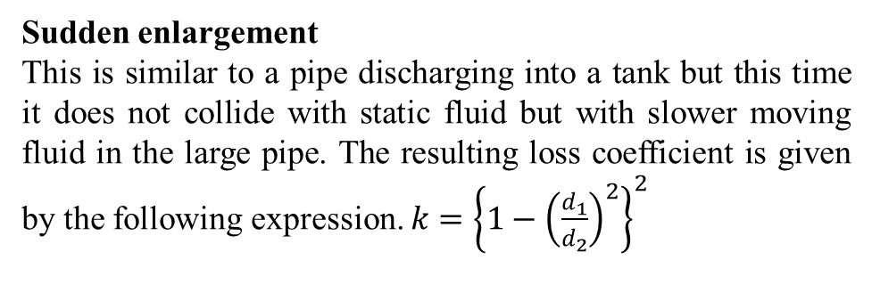
Exit from a pipe into a tank.
The liquid emerges from the pipe and collides with stationary liquid causing it to swirl about before finally coming to rest. All the kinetic energy is dissipated by friction. It follows that all the kinetic head is lost so k = 1.0
Entry to a pipe from a tank
The value of k varies from 0.78 to 0.04 depending on the shape of the inlet. A good rounded inlet has a low value but the case shown is the worst.
Sudden enlargement
This is similar to a pipe discharging into a tank but this time it does not collide with static fluid but with slower moving fluid in the large pipe. The resulting loss coefficient is given by the following expression. $k={\left\{1−{\left(\frac{d_{1}}{d_{2}}\right)}^{2}\right\}}^{2}$

Slide 28
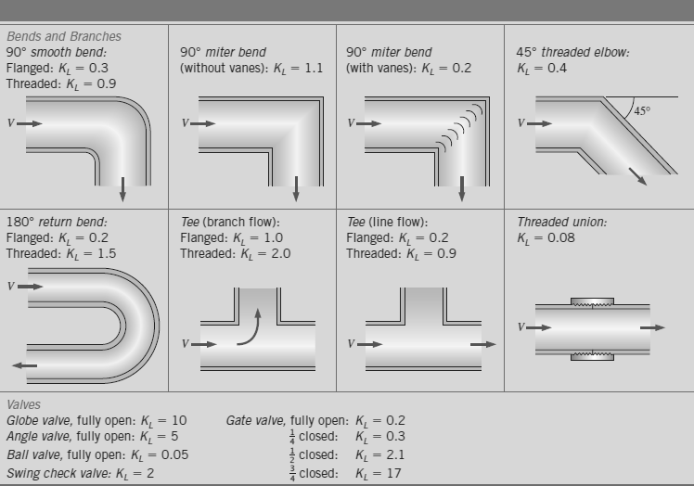
Sudden contraction
This is similar to the entry to a pipe from a tank. The best case gives k = 0 and the worst case is for a sharp corner which gives k = 0.5.
Bends and fittings

Slide 29
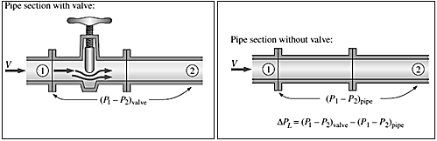
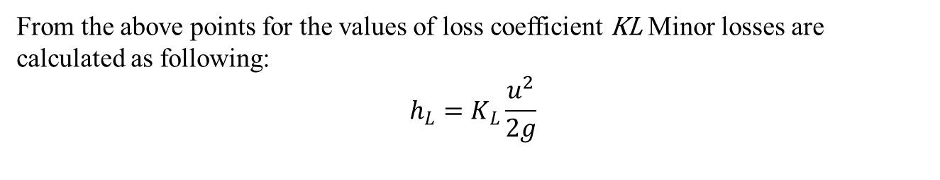
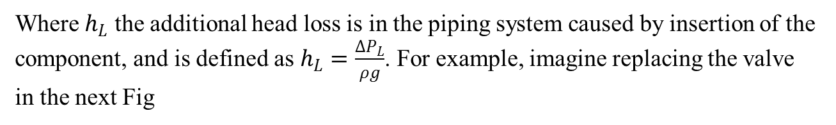
From the above points for the values of loss coefficient KL Minor losses are calculated as following:
$$h_{L}=K_{L}\frac{u^{2}}{2g}$$
Where $h_{L}$ the additional head loss is in the piping system caused by insertion of the component, and is defined as $h_{L}=\frac{∆P_{L}}{ρg}$. For example, imagine replacing the valve in the next Fig

Slide 30


Total Friction Losses
The frictional losses from the friction in the straight pipe (skin friction), enlargement losses, contraction losses, and losses in fittings and valves are all incorporated in h_{L} term in Bernoulli's equation, so that.
$$h_{L}=f\frac{l}{d}\frac{{u_{1}}^{2}}{2g}+K_{e}\frac{{u_{1}}^{2}}{2g}+K_{c}\frac{{u_{2}}^{2}}{2g}+K_{f}\frac{{u_{ }}^{2}}{2g}$$
$$h_{L}=f\frac{l}{d}\frac{{{\left(\frac{Q}{A_{1}}\right)}^{2}}^{ }}{2g}+K_{e}\frac{{\left(\frac{Q}{A_{1}}\right)}^{2}}{2g}+K_{c}\frac{{\left(\frac{Q}{A_{2}}\right)}^{2}}{2g}+K_{f}\frac{{\left(\frac{Q}{A_{ }}\right)}^{2}}{2g}$$
$$h_{L}=\left(\frac{8fL}{π^{2}g{d^{ }}_{1}^{5}}+\frac{8K_{e}}{π^{2}g{d^{ }}_{1}^{4}}+\frac{8K_{c}}{π^{2}g{d^{ }}_{2}^{4}}+\frac{8K_{f}}{π^{2}g{d^{ }}_{ }^{4}}\right)×Q^{2}$$
If all the velocity u, u₁, and u₂ are the same, then this equation becomes, for this special case;
$$h_{L}=\left[f\frac{l}{d}+K_{e}+K_{c}+K_{f}\right]\frac{{u_{ }}^{2}}{2g}$$

Slide 31

EXTERNAL FLOW
Parallel flow over flat plate
Velocity boundary layer

Slide 32



DISCHARGE FROM A TANK THROUGH AN ORIFICE
Co-efficient of Discharge $(Cd)$
$$Cd=\frac{Q}{Q_{th}}=\frac{Actual velocity x Actual area}{Theoretical velocity x Theoretical area}$$
The value of $Cd$, varies from 0.61 to 0.65.

Slide 33



Experimental determination of co-efficient of discharge $(Cd)$.
The water is allowed to flow through an orifice fitted to a tank under a constant head, H
The water is collected in a measuring tank for a known time, $t$.
The height Of water in the measuring tank is noted down.
Then actual discharge through orifice:
$$Q_{act} =\frac{Area of measuring tank ×Height of water in measuring tank}{Time(t)}$$
$$Theoretical discharge = area of orifice × \sqrt{2gH}$$
$$Cd=\frac{Q_{act}}{a × \sqrt{2gH}}$$

Slide 34


Time Of Emptying A Tank Through An Orifice At Its Bottom
It is required to find the time for the liquid surface to fall from the height $H_{1}$ to a height $H_{2}$.
Let
A = Area of the tank
a = Area of the orifice
$H_{1}$ = Initial height of the liquid
$H_{2}$ = Final height of the liquid
T= Time in seconds for the liquid to fall from $H_{1}$ to $H_{2}$
Let at any lime, the height of liquid from orifice is h and let the liquid surface fall by a small height dh in time dT.
Then
Volume of liquid leaving the tank in time, $= A × dh$
Also the theoretical velocity through orifice, $u=\sqrt{2gh}$

Slide 35

VORTEX FLOW
Vortex flow is defined as the flow of a fluid along a curved path or the flow of a rotating mass of fluid is known a 'Vortex Flow". The vortex flow is of two types namely :
1. Forced vortex flow.
2. Free vortex flow.

Slide 36


Equation of Motion for Vortex Flow
Let
r= Radius of the element from 0.
$∆θ$ = Angle subtended by the element at 0.
$dr$ = Radial thickness of the element.
$d$A = Area of cross-section of element.

Slide 37

The pressure, p varies with respect to r and z or p is a function of r and z and hence total derivative of p is
$$dP=\frac{∂P}{∂r}dr+\frac{∂p}{∂z}dz$$
Substituting the values of $\frac{∂P}{∂r}$ from equation (a) and $\frac{∂p}{∂z}$ from equation (b), we get
$$dP=ρ\frac{ v^{2}}{r}dr−ρgdz (2)$$
Eq. (2) gives the variation of pressure of a rotating fluid in any plane

Slide 38


$$Z=\frac{v_{2}^{2}}{2g}=\frac{{w^{2}r}_{2}^{2}}{2g} (3)$$
Thus Z varies with the square of r. Hence equation (3) is an equation of parabola. This means the free surface of the liquid is a parabolic.

Slide 39


Slide 40


Slide 41



Closed Cylindrical Vessels
The Fig.(a) shows the initial stage of the cylinder, when it is not rotated.
Fig. (b) shows the shape of the parabolic formed when the speed of rotation is $w$.
If the speed is increased further say $w_{2}$, the shape of parabolic formed will be as shown in Fig. (c).
In this case the radius of the parabola at the top of the vessel is unknown. Also the height of the parabolic formed corresponding to angular speed $w_{2}$ is unknown. Thus to solve the two unknown, we should have two equations.
One equation is $Z=\frac{{w^{2}r}_{2}^{2}}{2g}$
Volume of air before rotation= Volume of parabolic formed $=\frac{πr^{2}}{2}Z$

Slide 42


